Slide 1

Internship at HDFC BANK, Mumbai
Name: Soham Shailendra Chaudhari
College: VJTI, Mumbai
Duration: 5th June - 5th August

Slide 2
MODEL DEPLOYMENT
USING
AZURE ML DESIGNER TOOL

Slide 3

CONTENT
01
PROBLEM STATEMENT
02
OBJECTIVES
03
SOLUTION METHODOLOGY
04
LIMITATIONS AND BENEFITS

Slide 4

PROBLEM STATEMENT
Model building, Model training, Model deployment(to Batch and Realtime Endpoint), and Consuming the deployed model by using the Azure Machine Learning Designer tool.

Slide 5
OBJECTIVES

Slide 6

OBJECTIVES
To upload the data and Fetch the data using external ADLS(Azure Data Lake Storage).
To create a Pipeline in the Azure ML Designer tool.
To perform Feature selection, train the model, model evaluation, and create the Job(Experiment) for the model.
To register the model
To deploy the registered model to the Batch endpoint and the Real-time endpoint.
To consume the deployed model.

Slide 7
SOLUTION METHODOLOGY

Slide 8
SOLUTION METHODOLOGY
Create an Azure Storage account (ADLS)
Create the Data Asset
Create Designer Model
Evaluate Job
Register Model
Create Environment for Deployment
Deployment to Batch Endpoint
Deployment to Real-time Endpoint

Slide 9
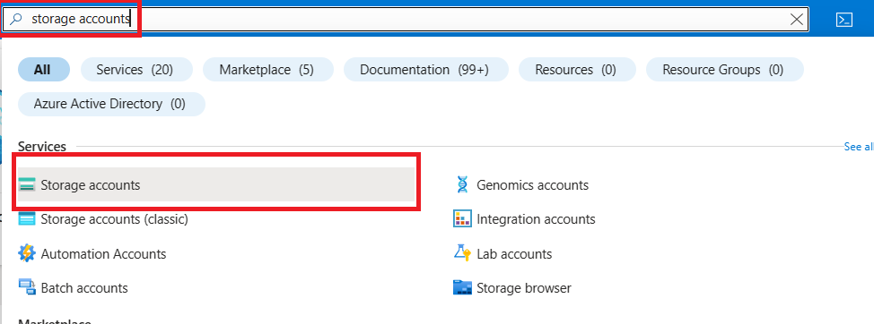
1. CREATE AN AZURE STORAGE ACCOUNT (ADLS)

Slide 10
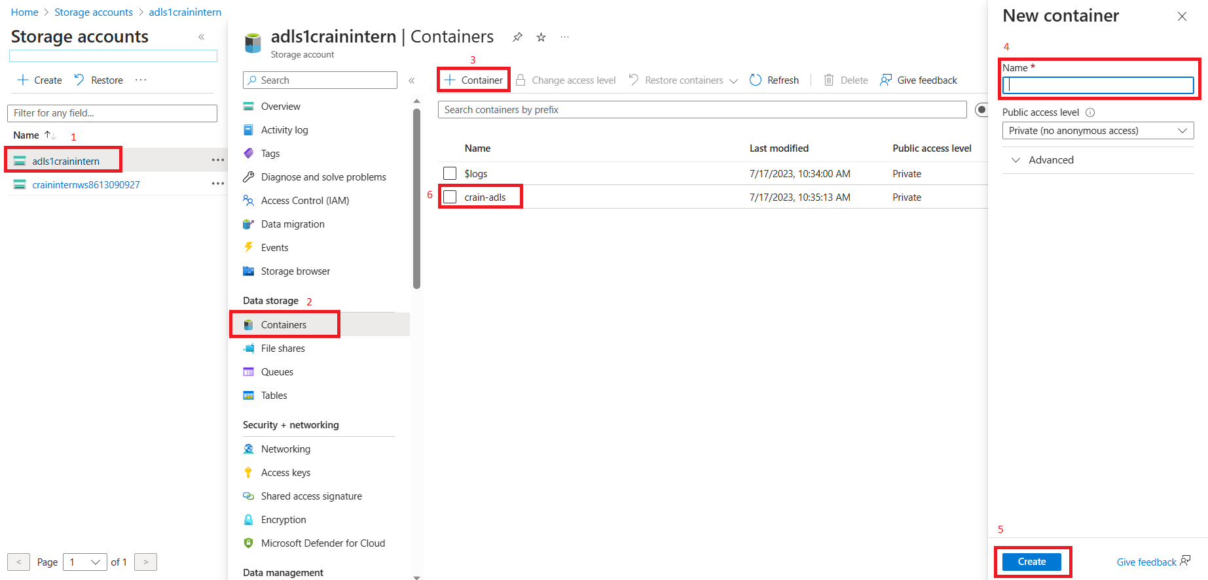

Slide 11
Once ADLS gets created we can upload our dataset inside the ADLS.
Further we can create Data Asset inside Azure ML Studio to use this data in Designer Pipeline.

Slide 12
2. CREATE THE DATA ASSET
To use the dataset in ADLS we must create the data asset in Azure ML Studio so that we can use that dataset or file for training or testing purposes.
Changes made inside ADLS get reflected inside the data asset created.
While creating the data asset, select the ADLS path where the data file is present and Click on Review and Create.

Slide 13
3. CREATE DESIGNER MODEL
Azure ML Designer tool is a no-code platform.
To create a model inside the designer tool we can drag and drop different components required to build our model.
To run the designer pipeline we require the Compute Cluster.
Once we SUBMIT the pipeline the Job gets created where we can evaluate our model.

Slide 14
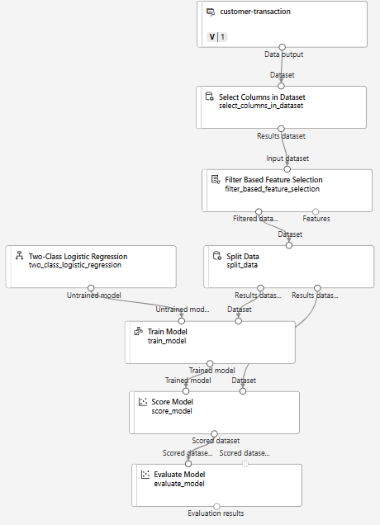

Slide 15
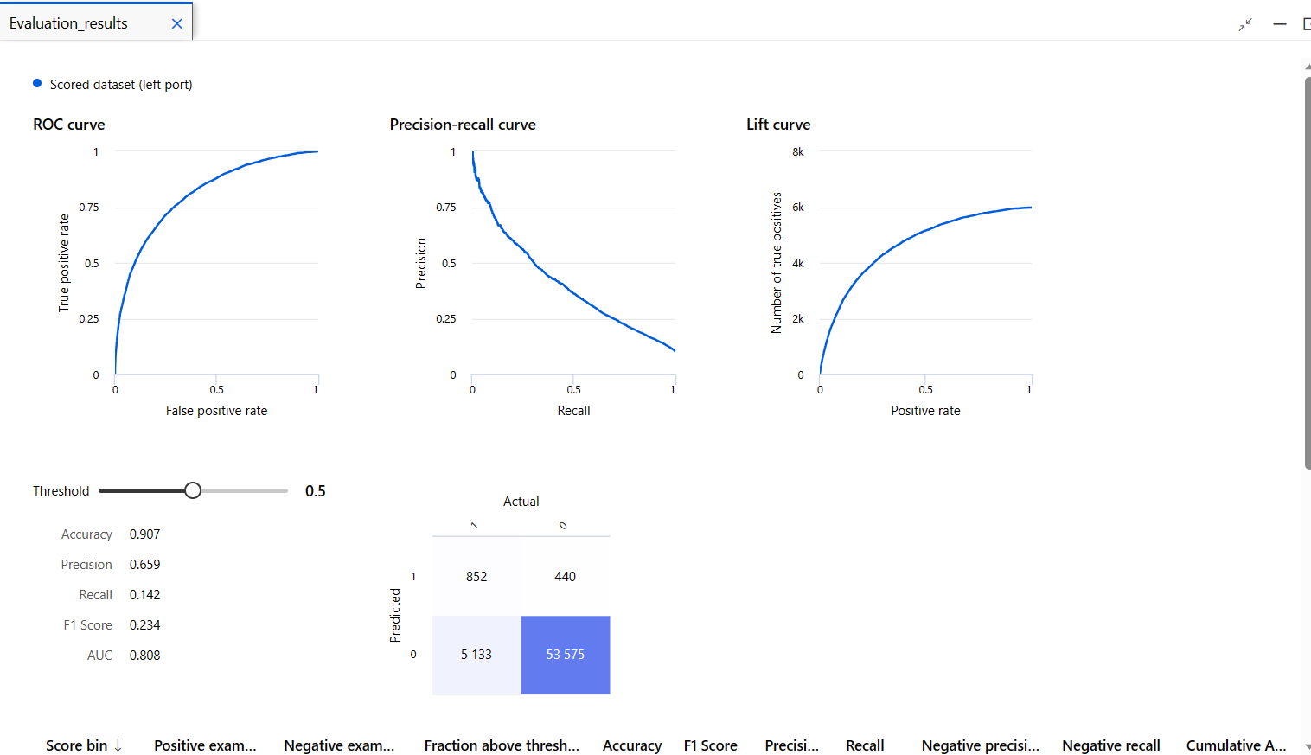
4. EVALUATE JOB

Slide 16
5. REGISTER MODEL
Once the Job gets executed successfully and we are satisfied with the results obtained from the job, we can register the model.
After registration check for score.py and conda_env.yaml files and download them because we will be using them for Batch-Deployment.

Slide 17
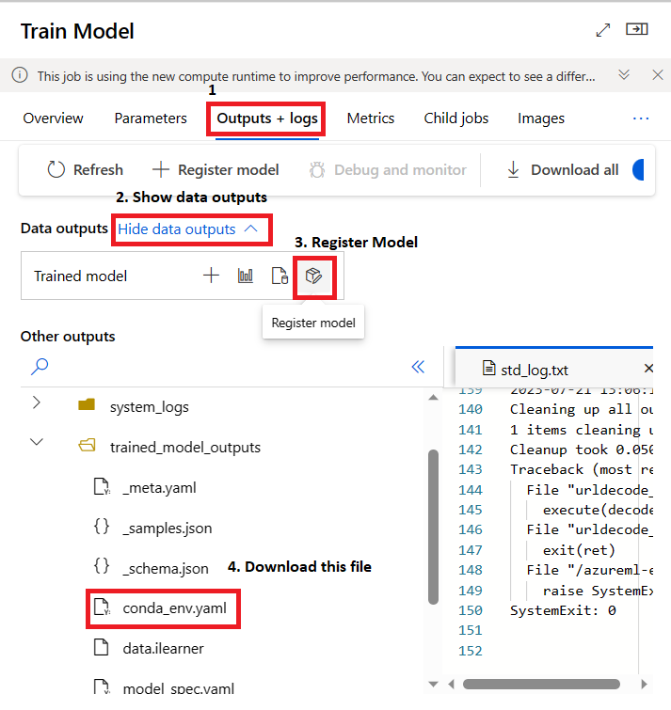

Slide 18
6. CREATE ENVIRONMENT FOR DEPLOYMENT
Environment is required for deployment, we can create this by using conda_env.yaml file.
Click on Environment tab and create new environment, and copy-paste the conda_env.yaml file code in the .yaml file.

Slide 19
7. DEPLOYMENT TO BATCH ENDPOINT
Create a data asset folder and pass the data in batches inside that folder.
Deploy the registered model to the batch endpoint and once the deployment is successful create the Job inside the batch deployment.
Use the score.py and Environment created in the previous steps.
Create a batch deployment Job and use the data asset in which the data is present in batches.
The output of this job will be stored in predictions.csv.

Slide 20
8. DEPLOYMENT TO REAL-TIME ENDPOINT
We can deploy the model to a real-time endpoint with the help of custom score.py.
But rather creating score.py, we can create inference pipeline with the help of Job.
Then after successful submission of that pipeline we can deploy that pipeline.
When we deploy this pipeline it registers the model and deploy the pipeline to Real-time endpoint. Hence we can deploy the model without writing any scoring code.
Once deployment state becomes Healthy we can consume this model.

Slide 21
LIMITATIONS & BENEFITS

Slide 22
LIMITATIONS
Library Installation
In Jupyter Notebook we can install libraries with the help of the pip install command but inside the designer tool, we cannot directly execute the pip install command and install any library.
Solution: Download the .whl file of the library required, then extract the required packages from that file, Zip all required packages, upload the zipped file inside data assets of the Azure ML Studio, and Use the zipped data asset as a component in designer tool and then we can execute the python script with all necessary libraries.

Slide 23
Deploy again after modification
Solutions
We can automate this process with the help of Azure Notebooks, by writing all the code for model training, registering, and deployment, and then we can execute all cells to deploy the model. (We can use MLFlow/AutoML libraries to automate the process.)
We can use Azure DevOps Pipelines to build and deploy the model. In Azure DevOps for every single commit on the main branch, the pipeline gets executed automatically and deploys the model. Although building the pipeline in Azure DevOps is more difficult than inside Azure ML Studio but once the pipeline is built then one can monitor the commits, check for modifications, and automate the complete process. (Limitation: Need to follow some folder structure.)

Slide 24
BENEFITS
No-Code Platform
We can perform almost every operation inside our Azure ML Designer tool which is needed for model training.
ADLS
Can use external Azure Data Lake Storage to store large dataset and use it inside Azure Designer.
Modifications in data present inside ADLS will automatically modify the data present inside Azure ML Data asset.
No need to store the files on our local machine.

Slide 25
Batch-Deployment
If the test data size is very large then we can divide the data into batches, pass the data inside the folder in Azure ML Data Asset and further we can create Batch Deployment Job to get output as a .csv file.
Inference Pipeline
Rathar than creating score.py file for custom deployment to real-time endpoint one can create an inference pipeline for easy deployment to the real-time endpoint.

Slide 26

THANK YOU!

